Slide 1

THE CANDY CACHE’S SUPPLY CHAIN OPTIMIZATION STRATEGY
Optimizing for Sweet Success by Debbie Go

Slide 2
Agenda
01 | Executive Summary
02 | Business Performance Snapshot
03 | Key Findings
04 | The Solution
05 | Actionable Recommendation

Slide 3
The Problem
The Impact:
The Solution:
68% Suboptimal routing
7.5 million unnecessary miles
$59,150 profit opportunity
$29,574 cost savings
Executive Summary
Our analysis reveals that Candy Cache’s logistics network is suboptimal. 68% of orders are not shipped from the closest factory, resulting in profit erosion. Advanced predictive modeling uncovered value creation, demonstrating the power of data-driven optimization.

Slide 4
Job to be Done
The Situation: The Candy Cache operates five factories serving North America but the current factory-customer assignments is misaligned and create unnecessary costs.
Job to be Done: To boost the company’s bottom line by identifying key inefficiencies in distribution routes and product strategy to unlock cost savings and drive profit growth through operational excellence.

Slide 5
The Approach: Data-Driven Analysis
📊 DATA
6 datasets
10,194 rows
🔬 ANALYSIS
Geospatial
Seasonality
What-If Analysis
Predictive Modelling
💡 INSIGHTS
Random Forest
94.9% accuracy
Key Drivers
🎯 ACTION
Decision Tool
Clear Recommendation
Key Assumptions:
This analysis assumes that switching costs between factories are negligible or zero and that geographically ‘nearest’ factories have the capacity to handle the increased volume from these rerouted orders. These assumptions should be validated before full implementation.

Slide 6
Business Snapshot
Overall business is healthy
Total Sales: $141,784 (89% above target)
Volume Growth Trend : 32% CAGR (2026-2030)
Sales Performance

Slide 7
Business Snapshot
Chocolate division is the engine, driving 93% of revenue
‘Chocolate’ and ‘Sugar’ divisions show healthier profit margins; while Other underdelivers on profit despite second highest in sales
Division Performance

Slide 8
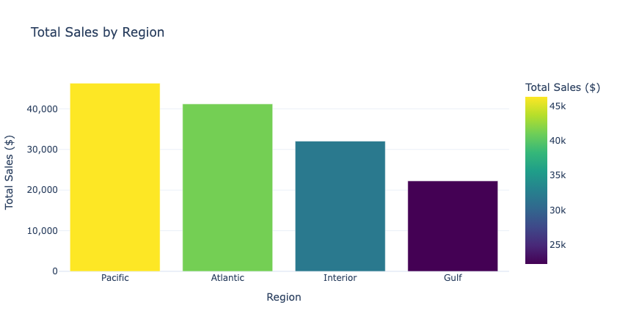
Business Snapshot
The Pacific and Atlantic regions (62% combined) regions are the most valuable markets
33%
Regional Performance
29%
23%
16%

Slide 9
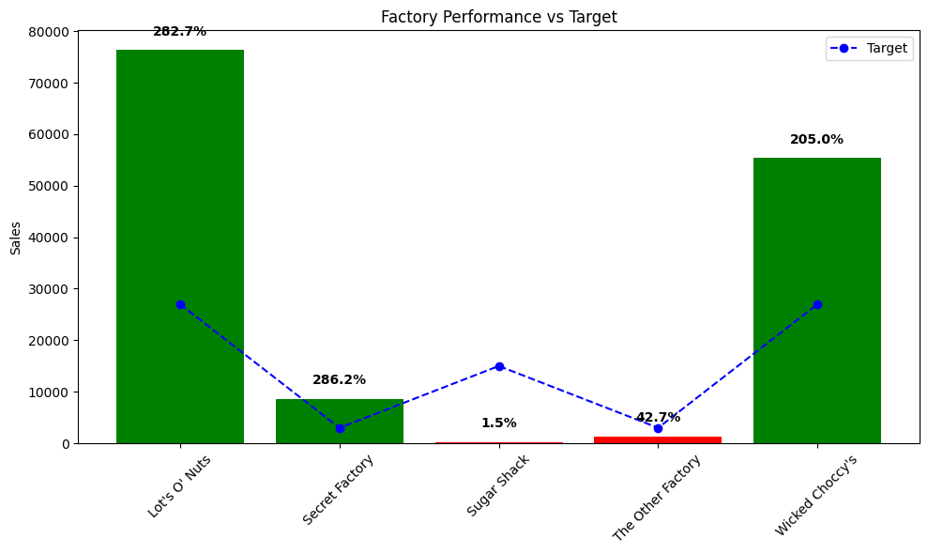
Business Snapshot
Lot’s O Nuts is the Top Performer ($76K, 54% of total sales) followed by Wicked Choccy’s ($55K, 39% of sales)
Efficient Route: Secret Factory with high profit/mile
Underperforming Factories: The Other Factory & Sugar Shack
Factory Performance

Slide 10

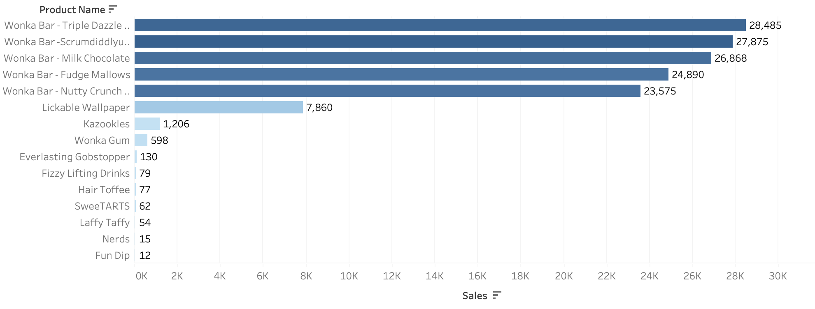
Business Snapshot
The Wonka Bar product line dominates = 90% of sales, with Triple Dazzle Caramel and Scrumdiddlyumptious varieties leading the pack
Product Performance

Slide 11
Business Snapshot
While Wonka Bars are the revenue drivers, specialty products like Lickable Wallpaper & Everlasting Gobstopper offer exceptional profit margins – Opportunity for strategic product mix optimization.
High
💡HIGH PROFIT/LOW SALES
Lickable Wallpaper ($10)
Everlasting Gobstopper ($8)
Hair Toffee ($3.50)
👑 HIGH PROFIT/HIGH SALES
Currently Empty
⚠️LOW PROFIT/LOW SALES
Fizzy Lifting Drinks ($2.25), Laffy Taffy ($1.24), SweeTARTS, Nerds ($0.70), Wonka Gum ($0.65), Fun Dip ($0.60), Kazookles ($0.25)
PROFITABILITY PORTFOLIO MATRIX
💰LOW PROFIT/HIGH SALES
All 5 Wonka Bars ($2.11-$2.50)
Product Performance
Profit/Unit
Low
High
Volume

Slide 12
Business Snapshot
Demand Seasonality
Spring peak demand (March +367 units; May +645 units)
Summer lull July/August trough (-345 to -406 units)
Q4 underperformance – not winning its fair share of the Halloween & Christmas holiday season
Seasonal Patterns

Slide 13
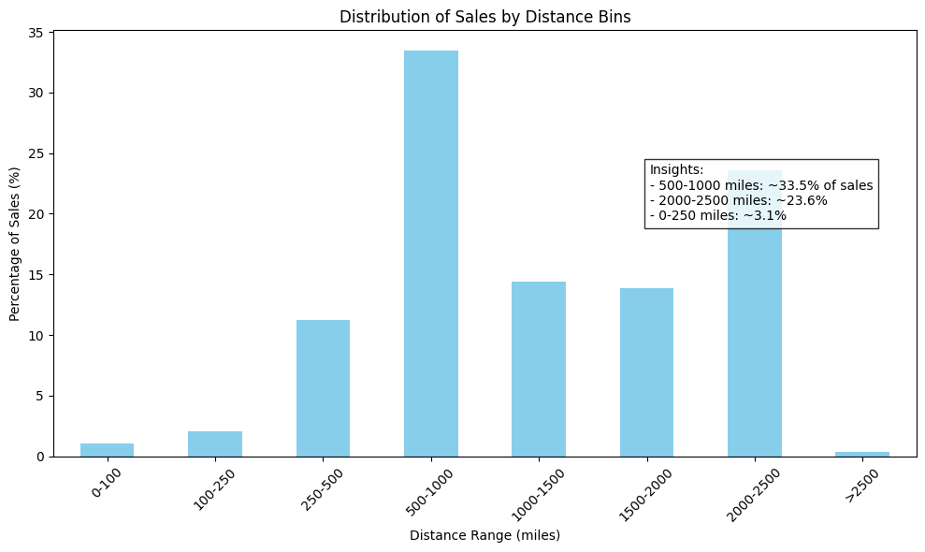
Geographic Distribution
57% of orders are shipped over long distances, which directly translates to higher shipping costs and reduced profitability.
What’s driving inefficiency

Slide 14
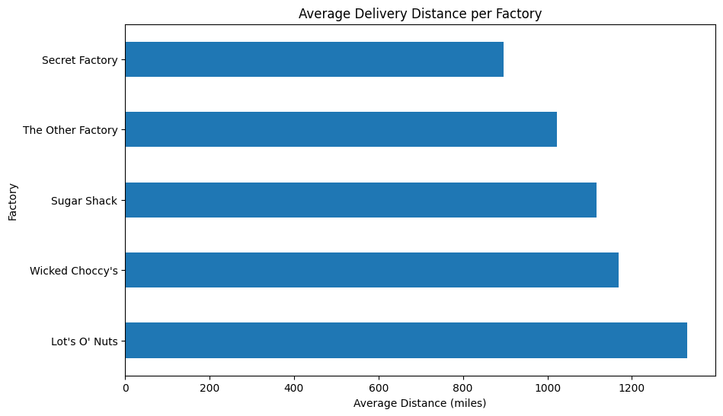
Geographic Distribution
Two factories, Lot’s O Nuts and Wicked Choccy’s have the highest average shipping distances, indicating a potential mismatch between factory location and customer base.
What’s driving inefficiency

Slide 15
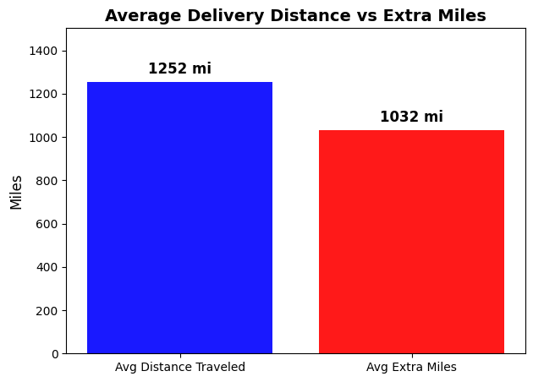
Geographic Distribution
Geographic misalignment costs with Factories serving distant customers. Orders travel an average of 1032 miles further than necessary.
What’s driving inefficiency

Slide 16
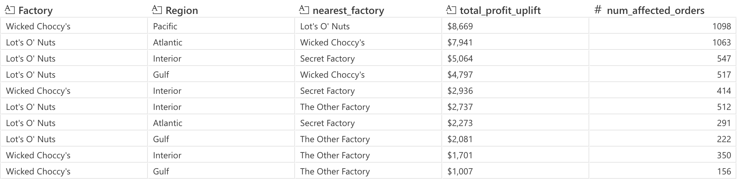
Current State Analysis
Factory Performance Gaps
Lots’ O Nuts is the top performer (+76K revenue), followed by Wicked Choccy’s (+55K revenue) but suffers but routing inefficiency
Top 10 Most Profitable Factory Re-Routing Opportunities
What’s driving inefficiency

Slide 17
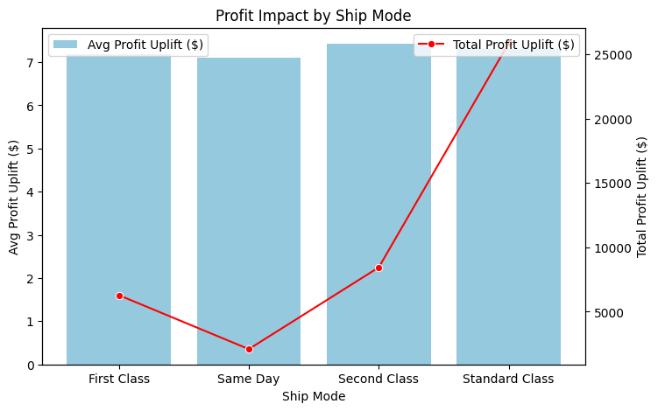
Current State Analysis
Standard Class is the Gold standard for Shipping
Standard Class is is the most profitable mode, generating 60% of gross profit
Faster shipping modes, while providing customer convenience, are less profitable
What’s driving inefficiency

Slide 18
The Opportunity
Random Forest Model Unlocks More Value than the Initial Analysis
38% value creation unlocked through advanced analytics
Scalable solution – applies to all current and future orders
Operational excellence drives margin
METRIC | INITIAL ANALYSIS
Profit Uplift | $42,704
Cost Savings | $21,629
Accuracy | Rule-based
Uplift as % of Current GP ($93,443) | 46%
PREDICTIVE MODEL (RF) | RF IMPROVEMENT
$59,150 | +39%
$29,574 | +37%
94.9% accuracy | Precise
63% | +17%
Pre-Modeling Analysis vs Predictive Model Results

Slide 19
The Solution
Random Forest Model achieves 94.9% accuracy and is 75% more precise than baseline Linear Regression model
Model Accuracy: 94.9% accuracy
Prediction error: off by 16¢ (vs 63¢ baseline LR)
Complex relationship capture: Units x Distance x Product x Cost
METRIC | LINEAR REGRESSION (LR) | RANDOM FOREST (RF) | RF IMPROVEMENT
Test MAE (Mean Absolute Error) | 0.625 Off by 63 cents | 0.156 Off by 16 cents | 75% better
Test R² | 89.6% accuracy | 94.9% accuracy | +5.9% higher
Predictive Modeling (LR vs RF)

Slide 20
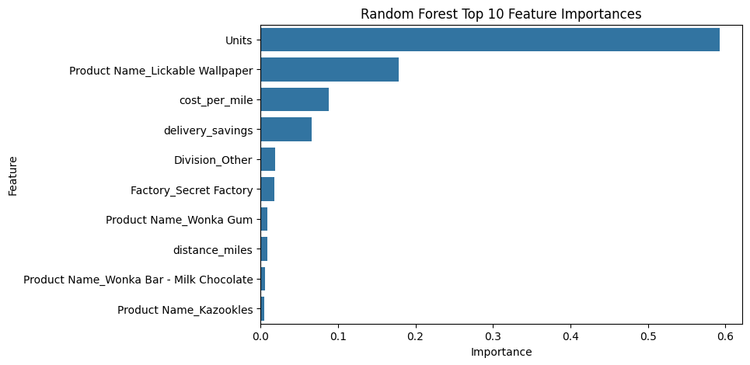
The Solution
Key Drivers of Profit
Sales Volume (units sold)
Product Mix (high-margin items)
Logistic Efficiency (cost per mile)
Geographic Optimization (delivery savings)
Predictive Modeling approach

Slide 21
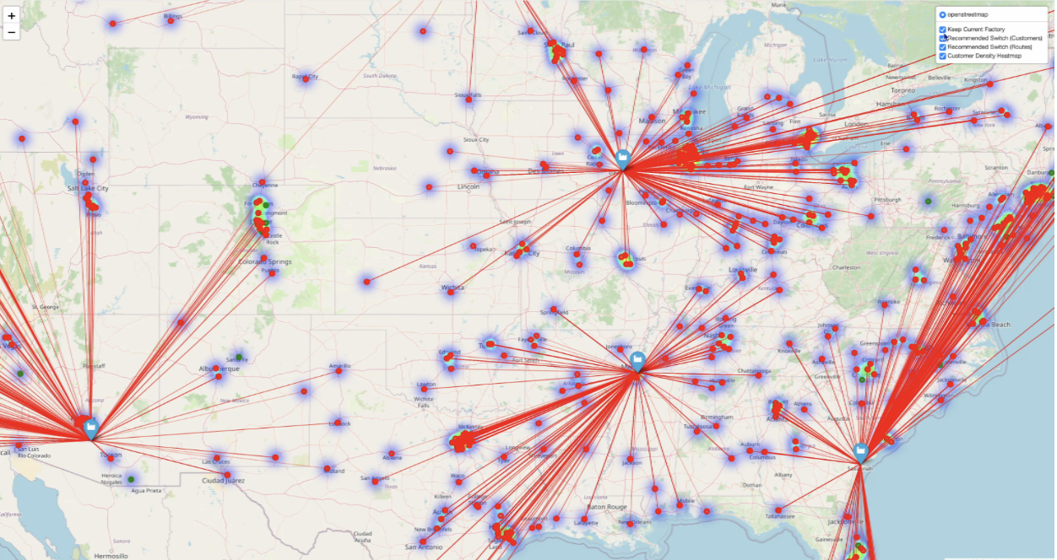
Actionable Recommendations
Implement “Ship from Nearest” Policy
Make shipping from the geographically nearest factory the default standard for all future orders.
Only 32% of orders ship from nearest factory
The Path to $88K in New Profit

Slide 22
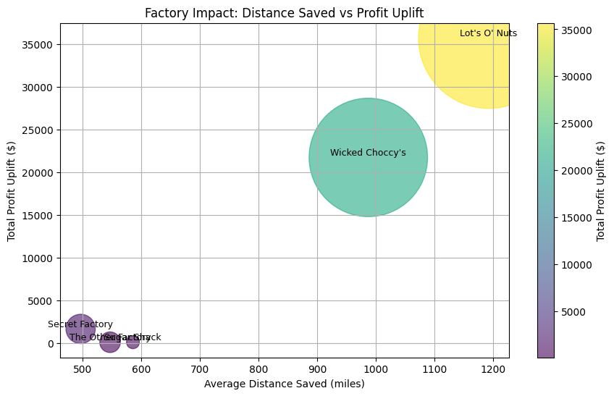
Actionable Recommendations
Optimize Routes
Re-route the 5,850 inefficient orders, focusing first on re-assigning shipments between Lot’s O Nuts and Wicked Choccy’s to capture over $29,574 in profit uplift
Implement the factory re-routing changes during the Q3 low demand period to minimize business disruption
The Path to $88K in New Profit

Slide 23
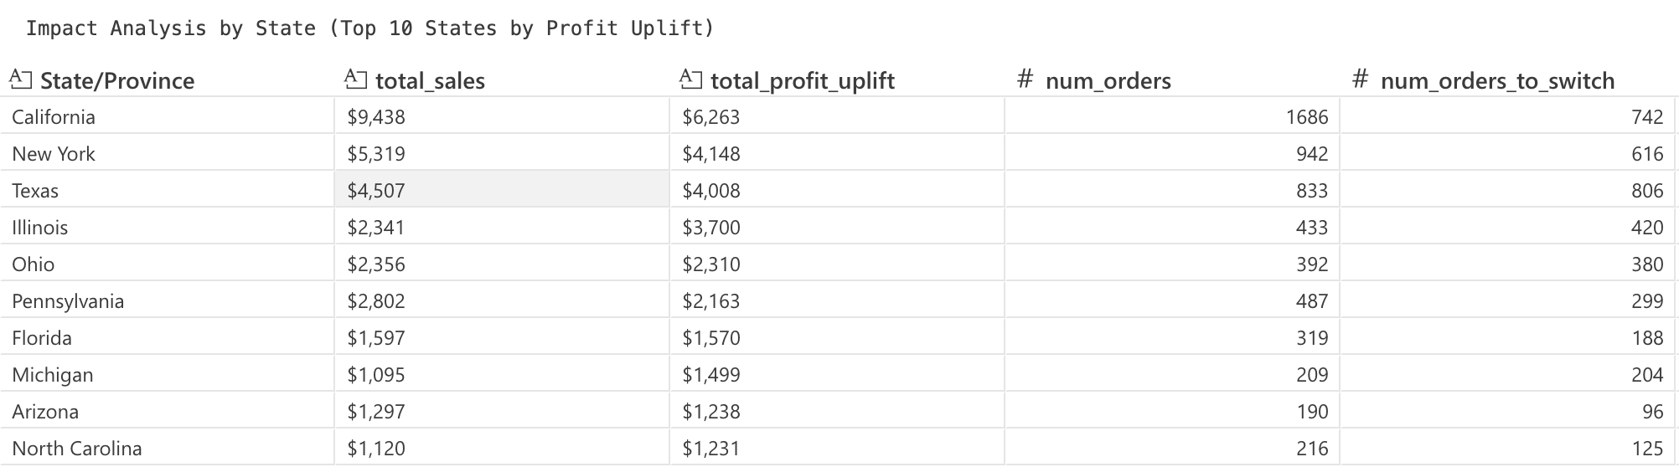
Actionable Recommendations
Focus on High-Impact States
Prioritize California, New York and Texas where route optimization potential are highest
The Path to $88K in New Profit

Slide 24
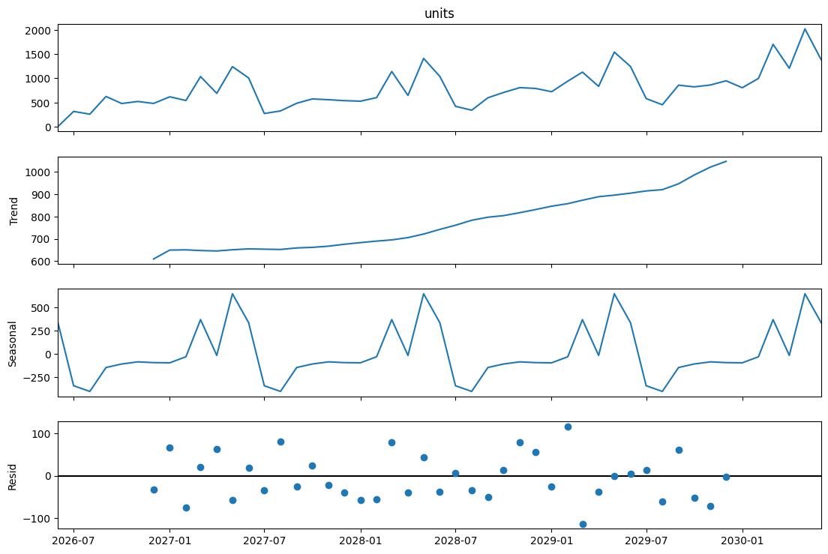
Actionable Recommendations
Align inventory and marketing with seasonal demand cycles
Dominate Spring: Ramp up production in anticipation of the demand surge (Mar-May) and launch major campaigns to capture Easter and Mother’s Day gifting.
Manage Summer: the summer lull efficiently (Jul-Aug) by optimizing costs with lean inventory
Win the Holidays: Develop a new Q4 playbook to capture market share during Halloween and Christmas season and reverse underperformance
The Path to $88K in New Profit

Slide 25
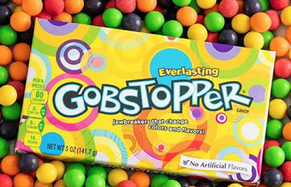
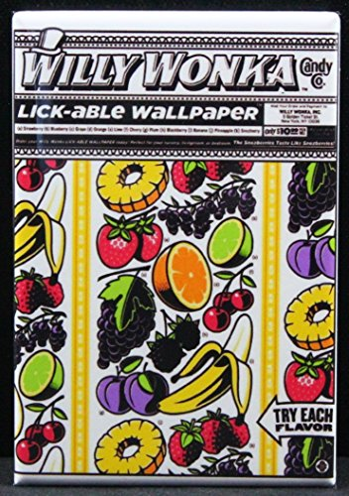

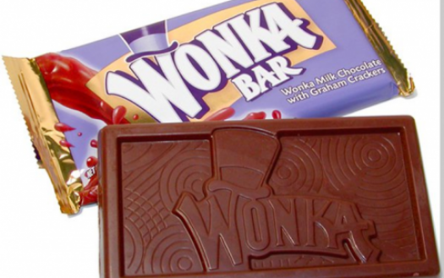
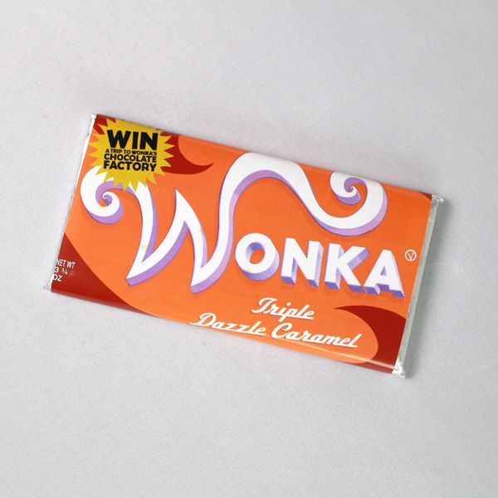
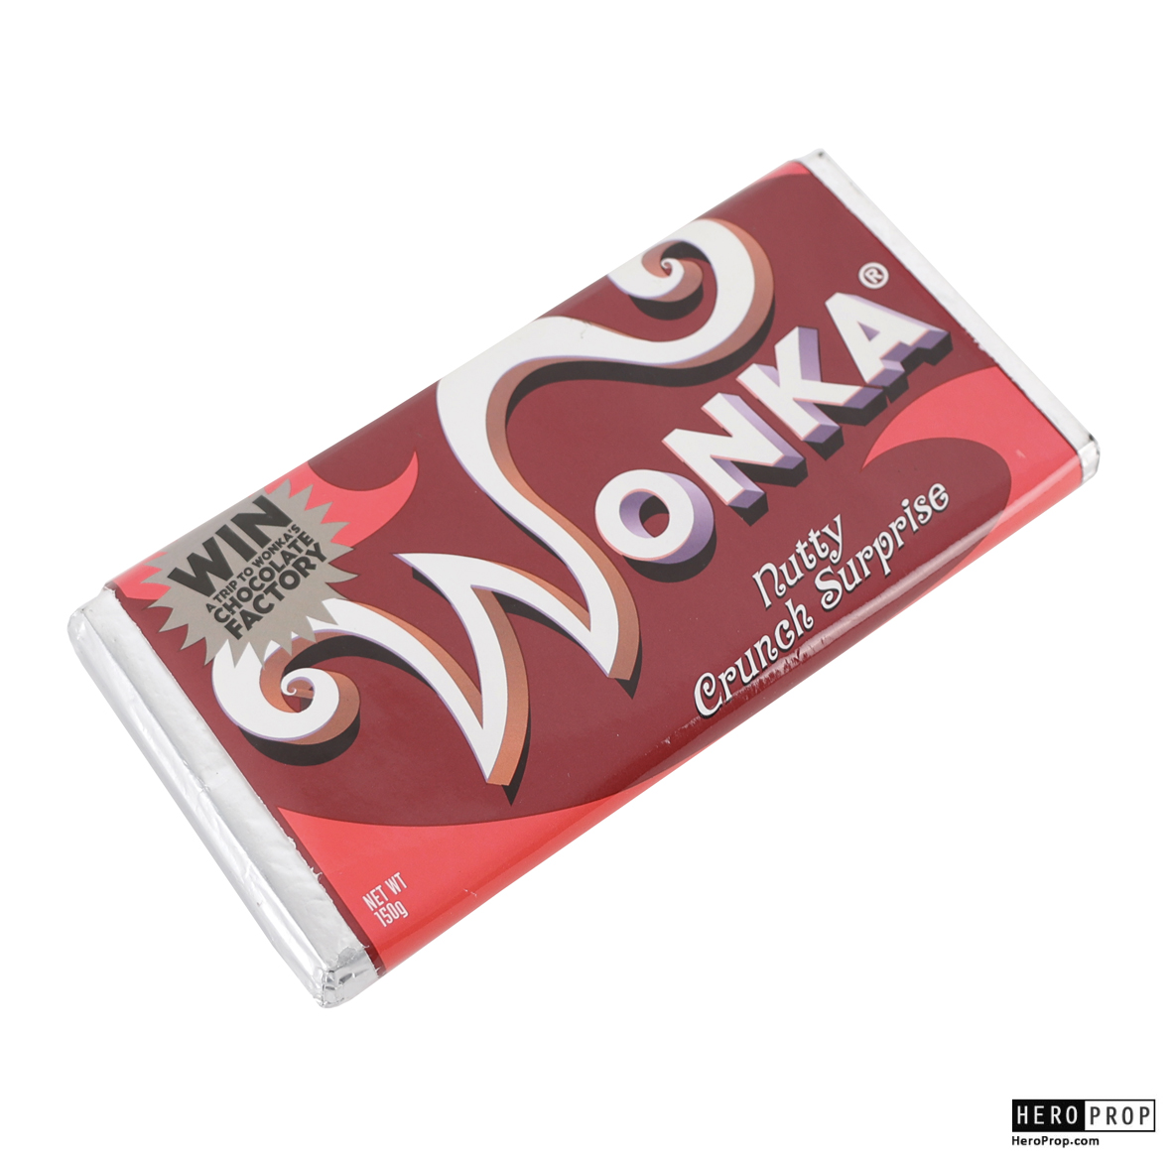
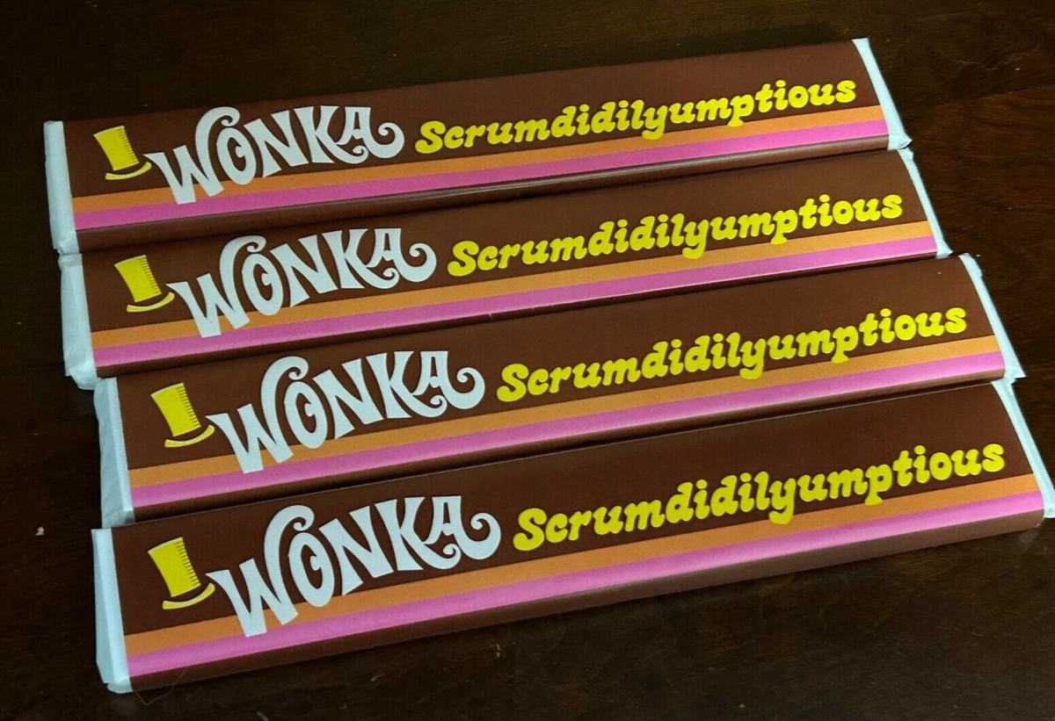
Actionable Recommendations
Review Operations & Product Mix
Launch an operational review of the Sugar Shack and The Other Factory to diagnose their underperformance
Strategically promote high-margin products like Lickable Wallpaper and Everlasting Gobstopper while defending Wonka Bar business
The Path to $88K in New Profit

Slide 26
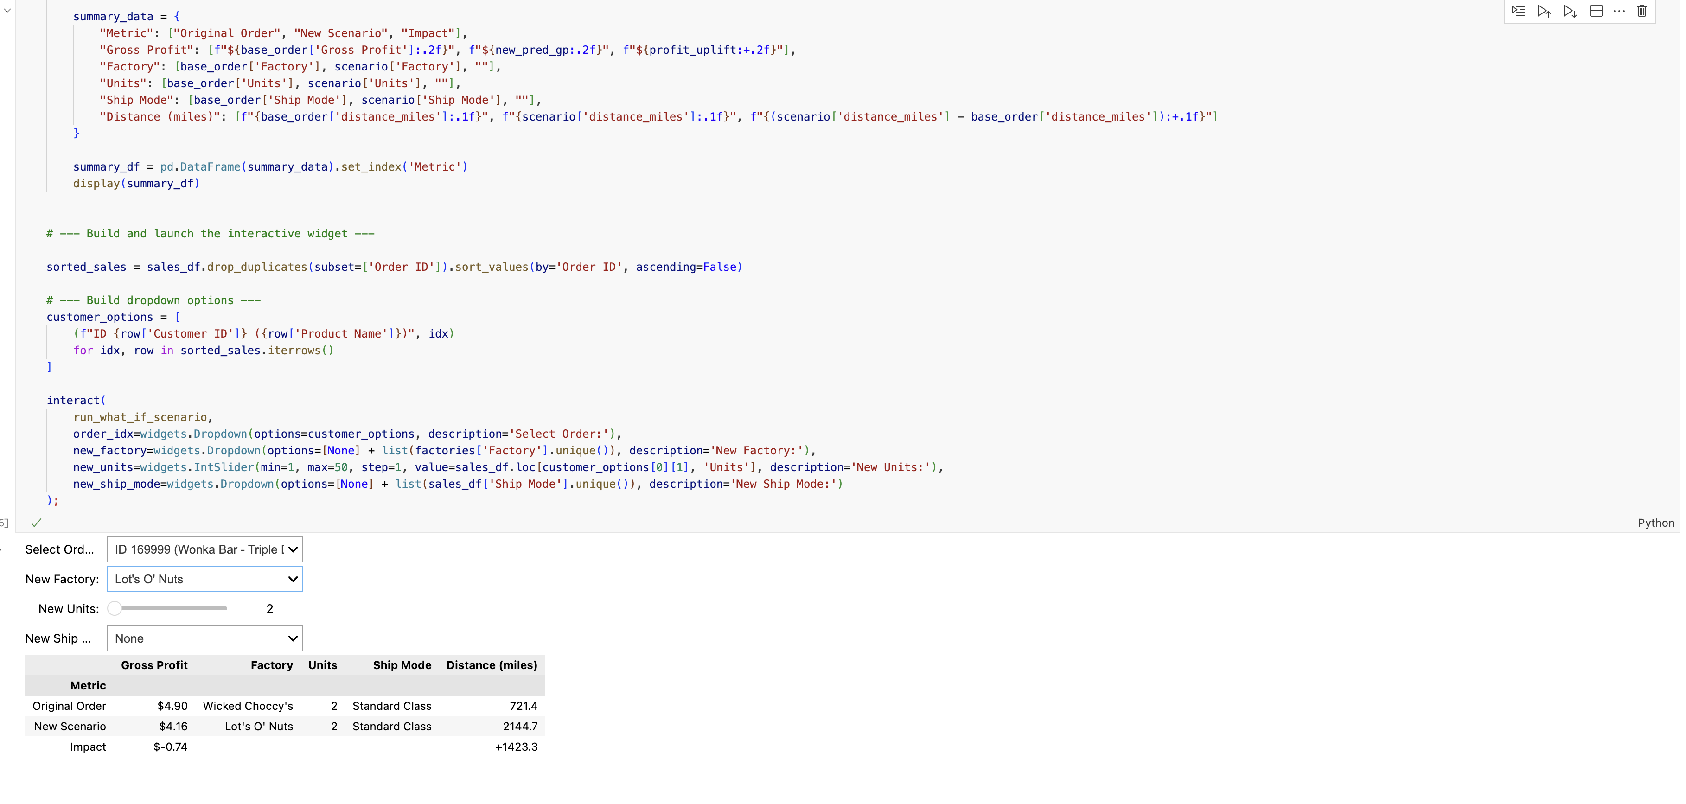
Actionable Recommendations
Adopt the new Decision-Support tool
Deploy the interactive ‘What-If’ analysis tool for real time routing optimization and profit forecasting
Turn supply chain into a competitive advantage
The Path to $88K in New Profit

Slide 27

Business Intelligence Tool
How it Works:
Test a Scenario
Simulate a Change
Generate a Prediction
Quantify the Impact ($)
Business Value:
Interactive “what If’ scenarios
Real-time profit impact calculations
No technical expertise required

Slide 28
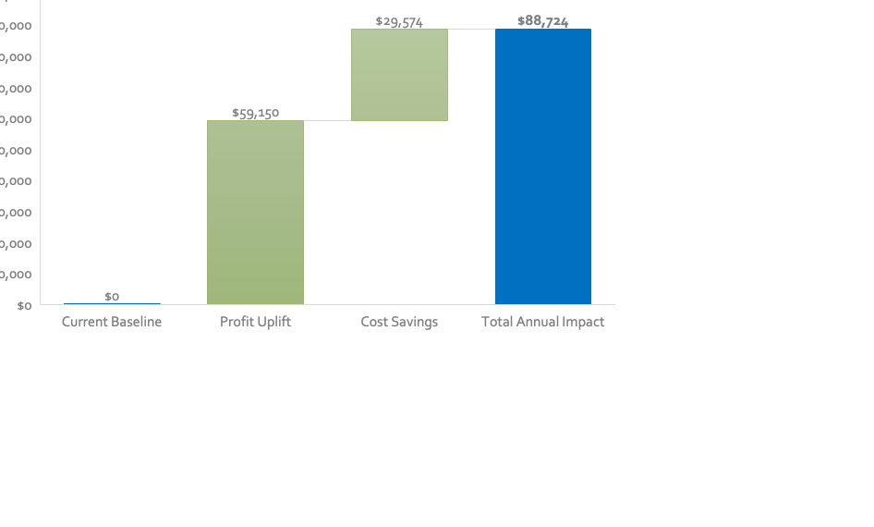
Total Profit Opportunity
Financial Impact Summary
Total Annual Benefit : $88,724
Profit Uplift: $59,150
Cost Savings: $29,574
Operational Efficiency: 7.5M miles saved
Decision Quality: 94.9% accurate forecasting

Slide 29

Ready to Capture the $88K Profit?

Slide 30

THANK YOU

Slide 31
Appendices

Slide 32

FACTORY
Product Lines

Slide 33
WICKED CHOCCY’S
$ 55,353 Sales
LOT’S O NUTS
$ 76,265 Sales

Slide 34
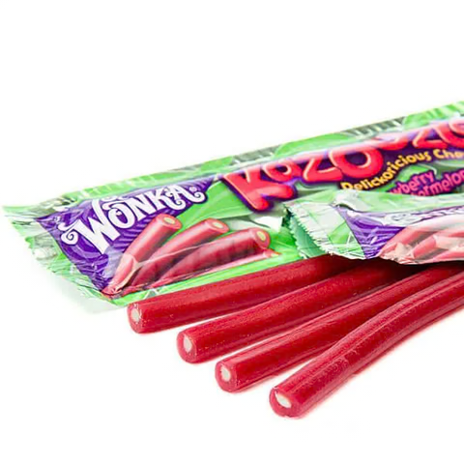
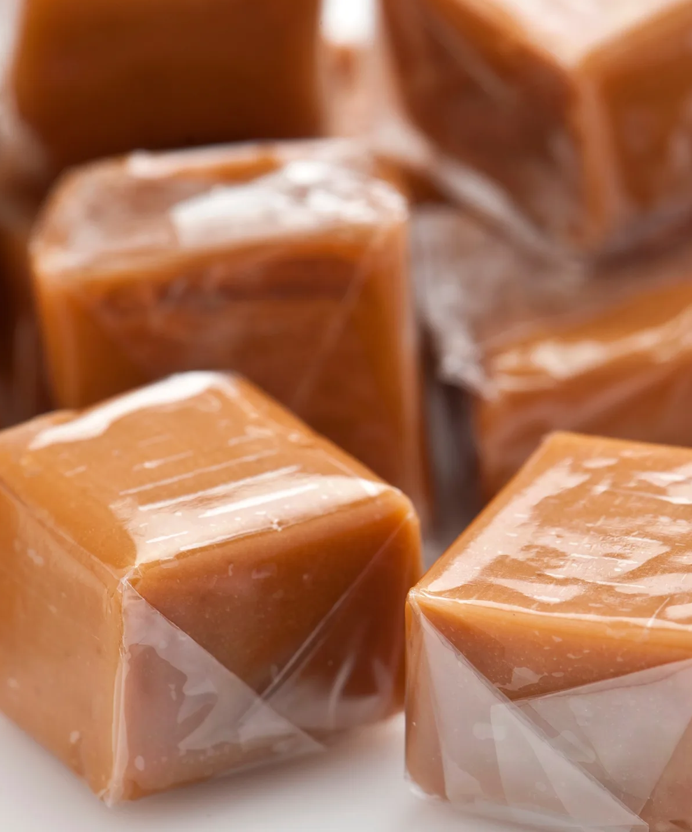
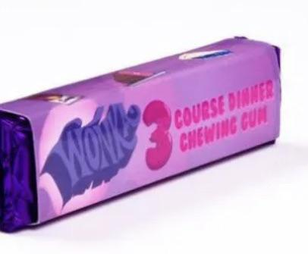
SECRET FACTORY
$8,587 Sales
THE OTHER FACTORY
$1,282 Sales

Slide 35

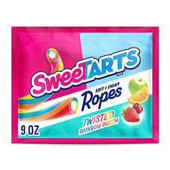

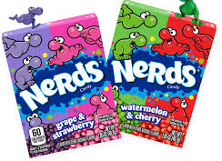
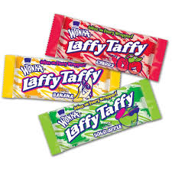
SUGAR SHACK
Sales: $220.98

